Slide 1
BLOXORZ
B07901020 劉昀昇

Slide 2
CONTENT
Brief introduction
Problem formulation
Bloxorz graph
CNF encoding
Definition
Constraint
Experiment

Slide 3
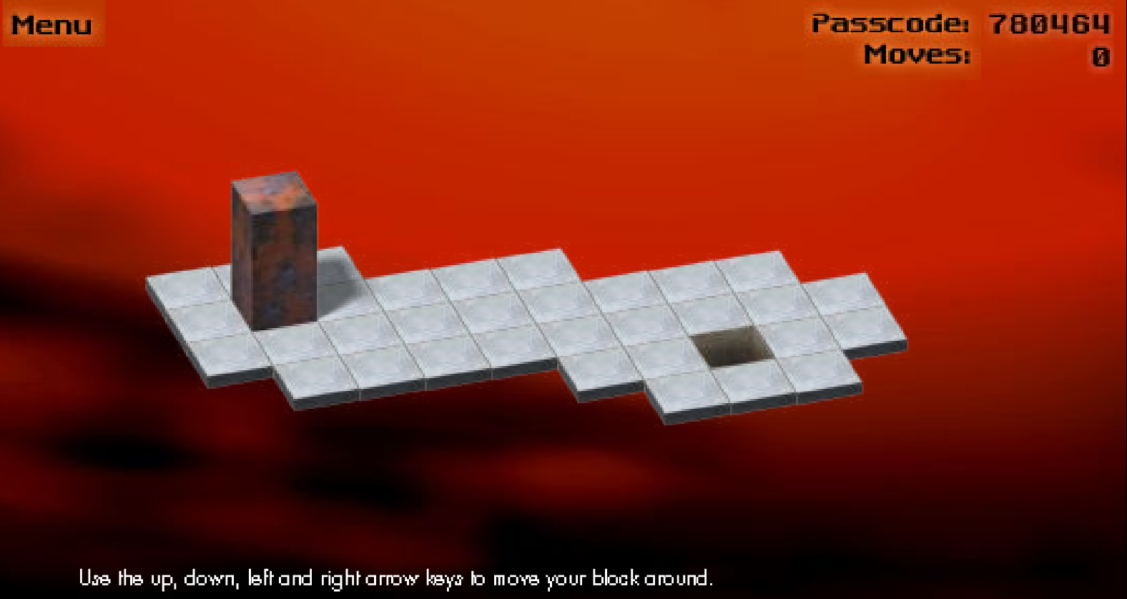
Brief introduction
https://www.mathplayground.com/logic_bloxorz.html
An online puzzle game where players move a 1 by 1 by 2 block by tilting it on a subset of the two dimensional grid. The block was moved from initial position to upright position on the destination square

Slide 4
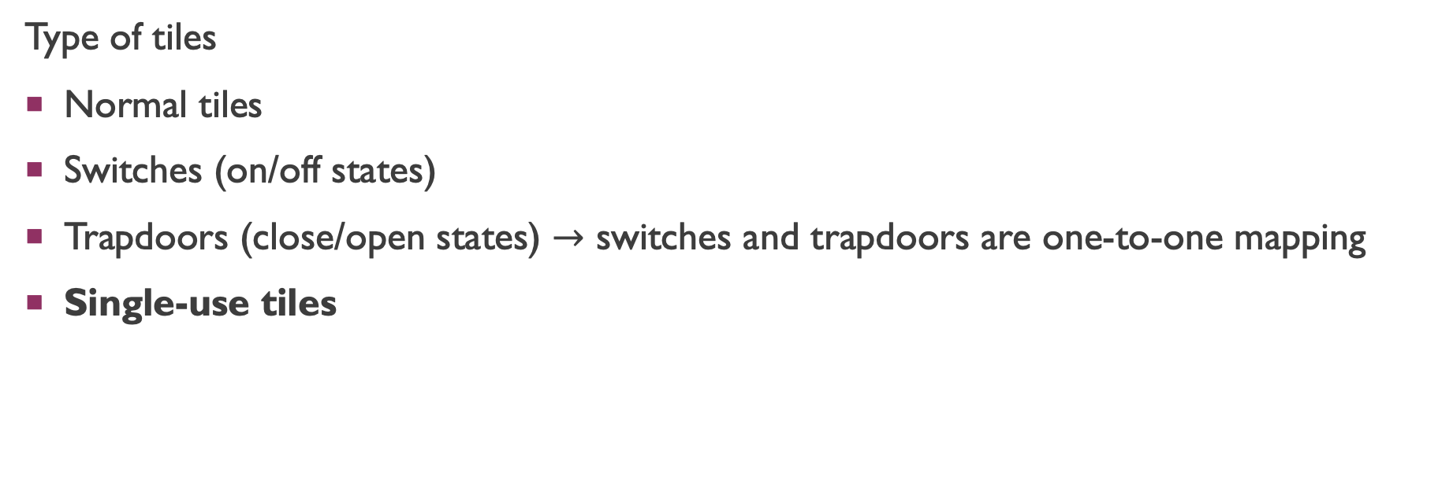
Brief introduction
Type of tiles
Normal tiles
Switches (on/off states)
Trapdoors (close/open states) $→$ switches and trapdoors are one-to-one mapping
Single-use tiles

Slide 5
Complexity of bloxorz
Dec. : decision problem
Opt. : optimization problem, whether it takes less than k steps
Here we focus on single-use tiles problem, it can be reduced from 3-CNF (NPC)

Slide 6
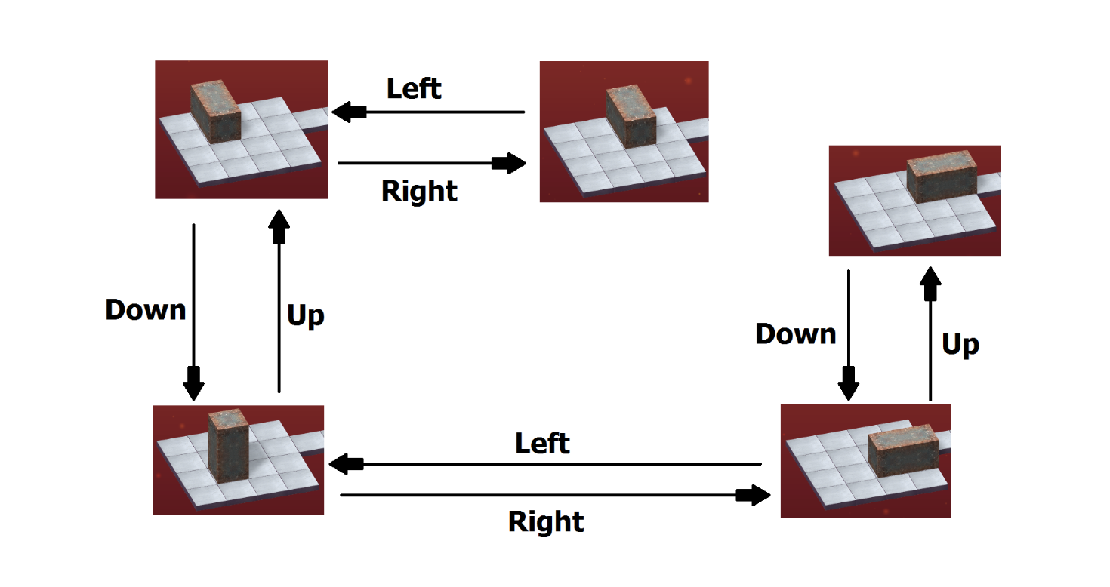
Problem formulation
Instance
Given a level of Bloxorz graph made up by a list of single-use tiles, and a 1 by 1 by 2 block
Question
Is there a sequence of legal move (right, left, down, up) to move from start point to up-right position on goal square

Slide 7
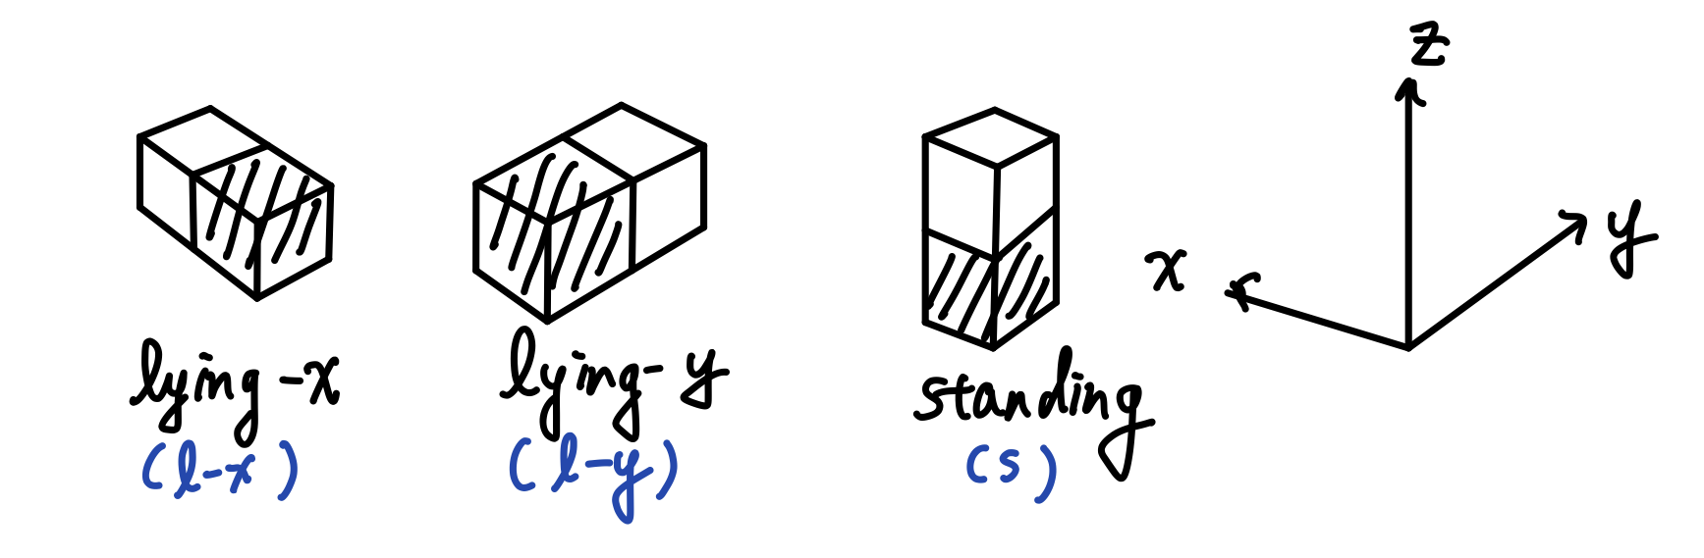

Bloxorz graph
Given a level of Bloxorz, suppose it has total $𝔹$ tiles. For each grid $𝕓_{i}$ the block can have three unique states on it (choose the closer-to-origin unit). As a result, $𝕓_{i}$ can be mapped to three vertex $v_{i_{I_{x}}}, v_{i_{I_{y}}}, v_{i_{s}}$. There are total $3∙|𝔹|$ vertices.

Slide 8
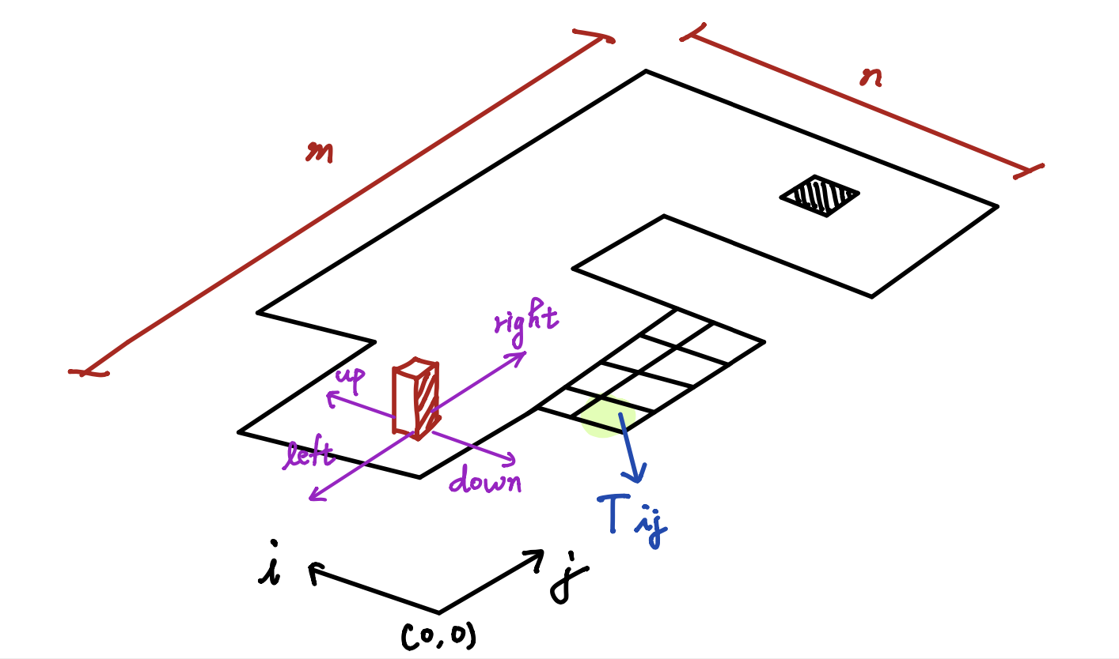
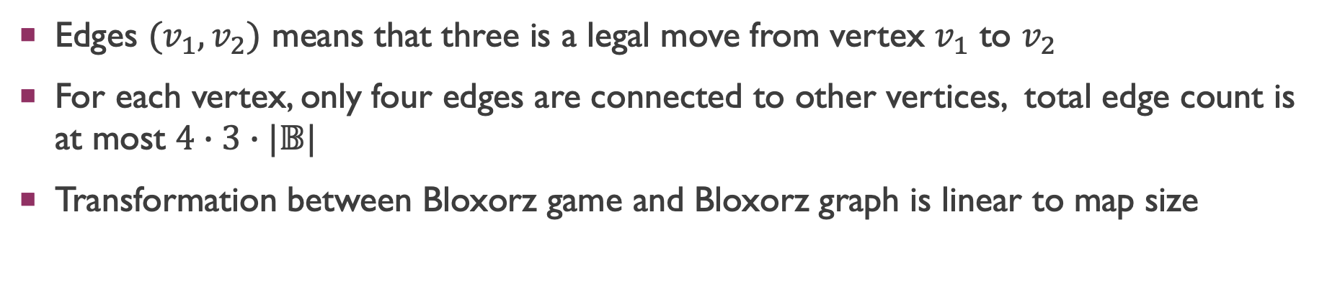
Bloxorz graph
Edges $(v_{1},v_{2})$ means that three is a legal move from vertex $v_{1}$ to $v_{2}$
For each vertex, only four edges are connected to other vertices, total edge count is at most $4∙3∙|𝔹|$
Transformation between Bloxorz game and Bloxorz graph is linear to map size

Slide 9
CNF encoding

Slide 10
Overall idea
Select a bunch of nodes on Bloxorz graph (these node incorporate location and state info of the block)
Check whether there exist a set of moves (edge) assigned on each selected nodes, to achieve path connection from start to end

Slide 11
definition

Slide 12
constraint

